Slide 1
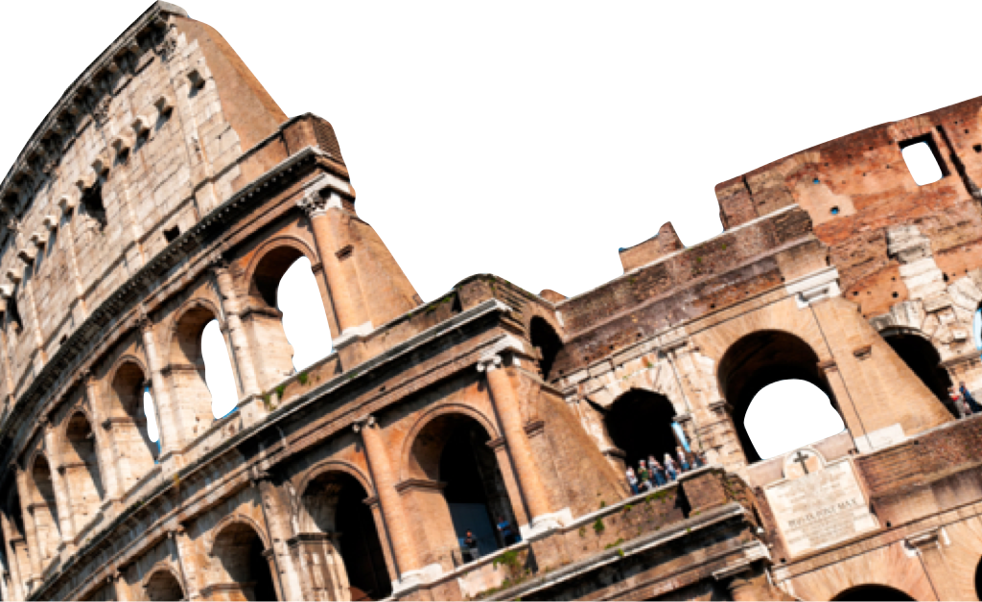
ROMANS
The Prosecution of Mankind
Romans 2:1-16
Laying a solid foundation
Jesse McLaughlin

Slide 2
Judgment of the Self-Righteous
Romans 2:1-4
Therefore you have no excuse, everyone of you who passes judgment, for in that which you judge another, you condemn yourself; for you who judge practice the same things. ² And we know that the judgment of God rightly falls upon those who practice such things. ³ But do you suppose this, O man, when you pass judgment on those who practice such things and do the same yourself, that you will escape the judgment of God?⁴ Or do you think lightly of the riches of His kindness and tolerance and patience, not knowing that the kindness of God leads you to repentance? (NASB)

Slide 3
Judgment of the Self-Righteous
Paul is addressing the good person or moralizer who thinks he can judge others.
Downplaying Sin:
Justification by comparison – “I am better than other people in this category.”
Tolerance of God – “A loving God will just let it go”
“[God’s kindness] is intended to give us space in which to repent, not to give us an excuse for sinning.”
– John Stott

Slide 4
Storing Up Wrath
Romans 2:5-11
⁵ But because of your stubbornness and unrepentant heart you are storing up wrath for yourself in the day of wrath and revelation of the righteous judgment of God, ⁶ who will render to each person according to his deeds: ⁷ to those who by perseverance in doing good seek for glory and honor and immortality, eternal life; ⁸ but to those who are selfishly ambitious and do not obey the truth, but obey unrighteousness, wrath and indignation. ⁹ There will be tribulation and distress for every soul of man who does evil, of the Jew first and also of the Greek, ¹⁰ but glory and honor and peace to everyone who does good, to the Jew first and also to the Greek. ¹¹ For there is no partiality with God. (NASB)

Slide 5
Storing Up Wrath
What is God’s Wrath?
“If then ‘grace’ is God acting graciously, ‘wrath’ must be God reacting in revulsion against sin. It is his ‘deeply personal abhorrence’ of evil…The alternative to ‘wrath’ is not ‘love’ but ‘neutrality’ in the moral conflict. And God is not neutral. On the contrary, his wrath is his holy hostility to evil, his refusal to condone it or come to terms with it, his just judgment upon it.
~John Stott, The Message of Romans
“The day of wrath” – Future event when God renders a verdict for the deeds of each person.
Why the delay of just punishment?

Slide 6
Storing Up Wrath
“The day of wrath” – Future event when God renders a verdict for the deeds of each person.
Why the delay of just punishment?
Those that count themselves as “good people” are not storing up the “riches of God’s kindness” (v. 4) but hoarding the wrath of God.
Wages for actions
No favoritism!

Slide 7
The Witness of law
Romans 2:12-16
¹² For all who have sinned without the Law will also perish without the Law, and all who have sinned under the Law will be judged by the Law; ¹³ for it is not the hearers of the Law who are just before God, but the doers of the Law will be justified. ¹⁴ For when Gentiles who do not have the Law do instinctively the things of the Law, these, not having the Law, are a law to themselves, ¹⁵ in that they show the work of the Law written in their hearts, their conscience bearing witness and their thoughts alternately accusing or else defending them, ¹⁶ on the day when, according to my gospel, God will judge the secrets of men through Christ Jesus. (NASB)

Slide 8
Storing Up Wrath
We will be judged by what we know not by standards of which we are ignorant.
The thoughts (v. 15) or secrets of men (v. 16) are the intentions hidden beneath every human action & interaction.

Slide 9
Matthew 5:21-22
“You have heard that it was said to the people long ago, ‘You shall not murder, and anyone who murders will be subject to judgment.’ But I tell you that anyone who is angry with a brother or sister will be subject to judgment. Again, anyone who says to a brother or sister, ‘Raca,’ is answerable to the court. And anyone who says, ‘You fool!’ will be in danger of the fire of hell.

Slide 10
Storing Up Wrath
We will be judged by what we know not by standards of which we are ignorant.
The thoughts (v. 15) or secrets of men (v. 16) are the intentions hidden beneath every human action & interaction.
The reason for missions work among unreached people is that ALL humanity will be called to account for their deeds and intentions.

Slide 11
Conclusion
God does not grant special privileges to anyone. All humans will be judged and declared guilty even people who appear good in this life. Only those found in Christ Jesus, the Savior & Judge, will be saved from God’s righteous wrath.
For I am not ashamed of the gospel, for it is the power of God for salvation to everyone who believes, to the Jew first and also to the Greek. –Romans 1:16

Slide 12
Discussion Questions
Which excuse below do you tend to use to overlook sin? What is wrong with such excuses?
“I am better than other people in this category”
“A loving God will just let it go”
How can your intentions be bad even when you are doing what appears to be a good thing?
How does the “day of wrath” (v. 5) fit into the message of the gospel?
What is Jesus inviting you to apply from this lesson?

